Slide 1
ML for Security and Security for ML

Slide 2
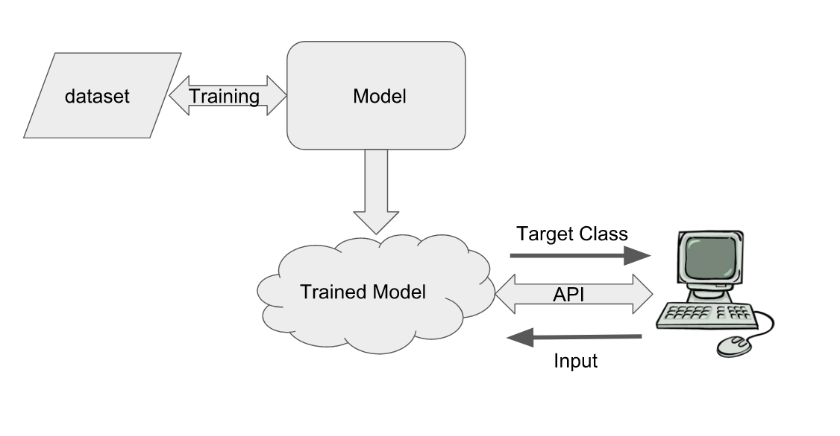
The “Pipeline”

Slide 3
Possible Attack Targets: Almost Everything
Poison Dataset
Skewed Models
Adversarial Attack
Steal Models
I/P Data inference
Framework Exploits
Network attacks

Slide 4
AI Security Assessment
Recon
Attack surface identification
Threat modeling
Adversarial Learning Attack
Model Stealing
Model Skewing
Input data inference
Model inversion
Hybrid attacks

Slide 5
The Recon
Intel on Application and Model internals
Research Papers, Blogs and product pages
Conference talks, demos, social media content for target application/appliance
Helps to plan efficient attack scenarios
Get your hands on target application

Slide 6
Adversarial Learning
Is our model actually “learning” what we expect it to learn?

Slide 7


Adversarial Learning
Specially craft an input with an intention to produce desired prediction from target model.
Street Sign
Perturbations
Mail Box

Slide 8
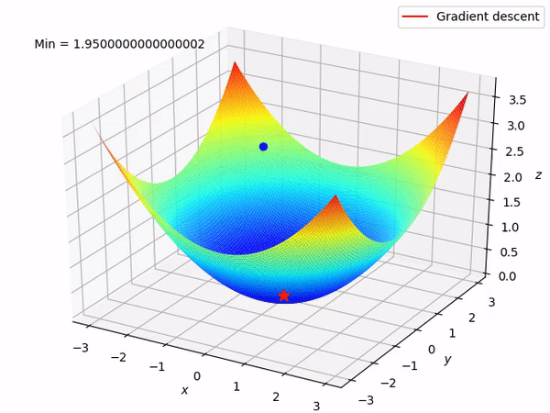
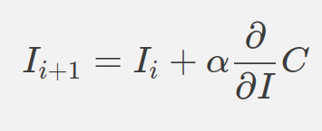
Adversarial Learning
Adversarial attack as an optimization problem

Slide 9
Adversarial Learning Attacks
Specially craft an input with an intention to produce desired prediction from target model.
Probability for target class
Adversarial Sample
Input Sample
Optimizer
{I}
{I’}

Slide 10


Adversarial Learning Attacks
Foolbox
Ref: https://github.com/bethgelab/foolbox
Cleverhans
Ref: https://github.com/cleverhans-lab/cleverhans

Slide 11
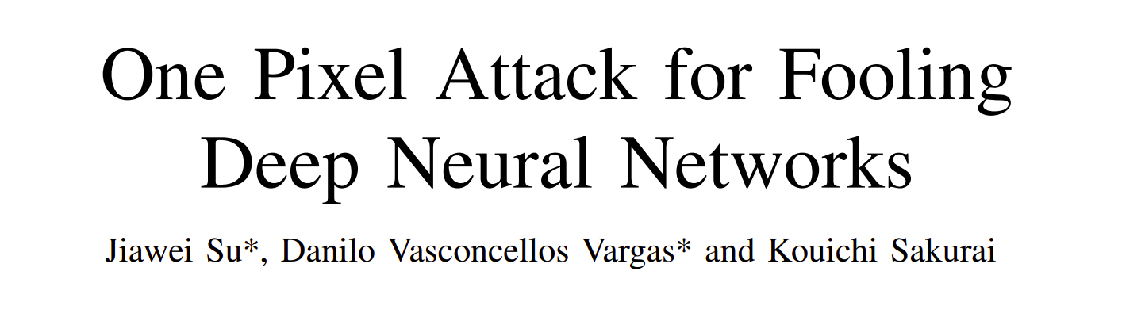
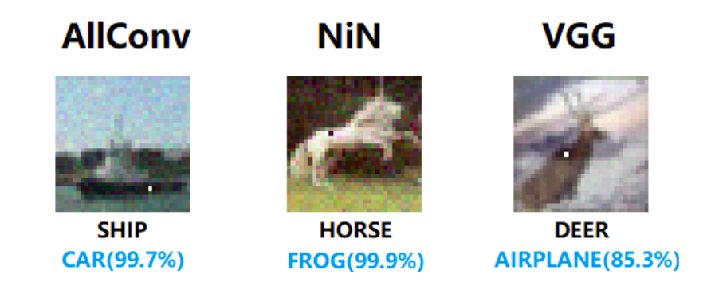
Experimental Adversarial attacks

Slide 12
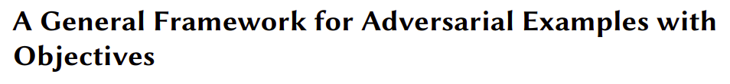
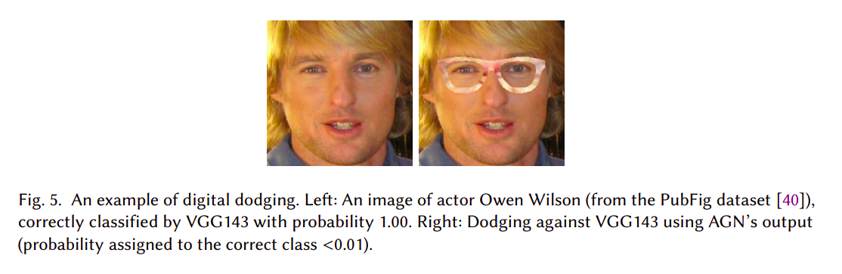
Experimental Adversarial attacks

Slide 13

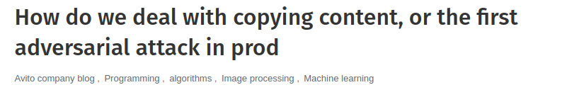
Realworld attacks

Slide 14
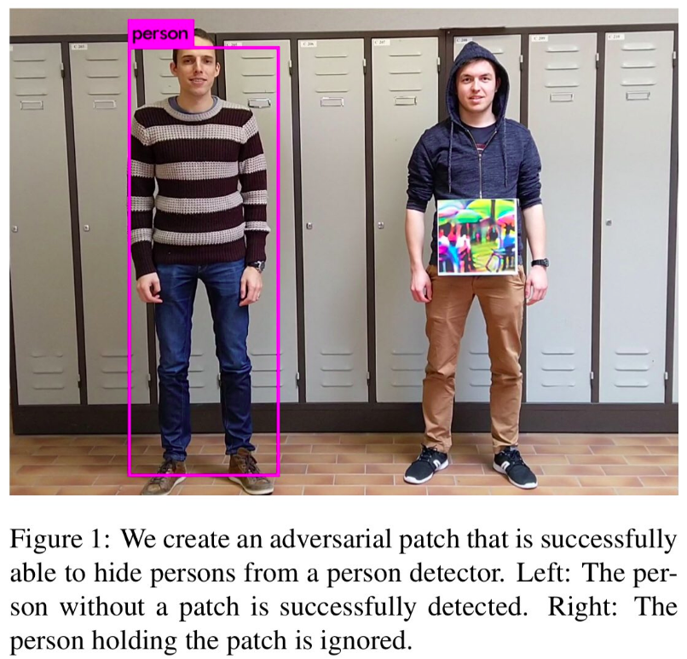
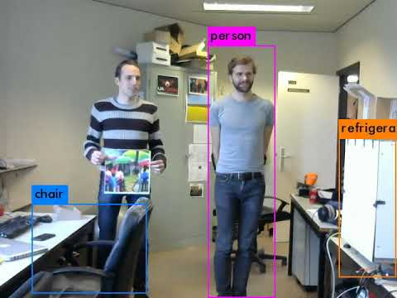
Realworld Adversarial attacks

Slide 15
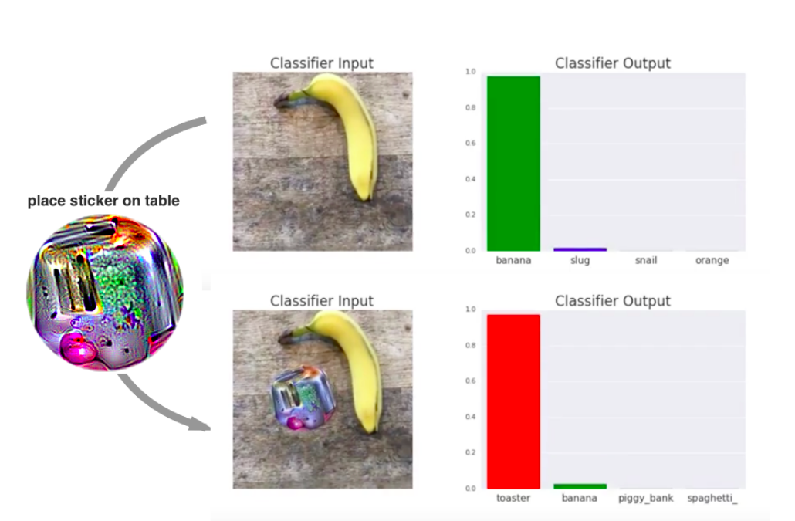
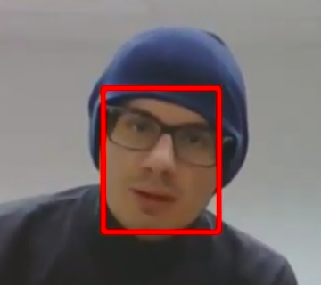
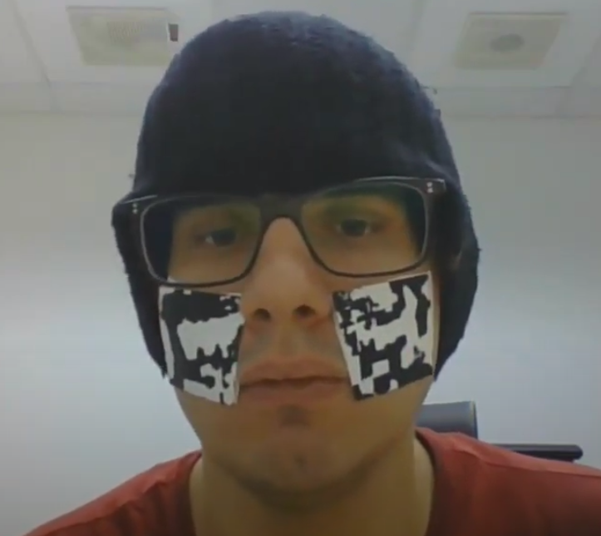
Adversarial Attacks in Physical Domain
https://arxiv.org/pdf/1712.09665.pdf
https://arxiv.org/pdf/1910.06261.pdf

Slide 16
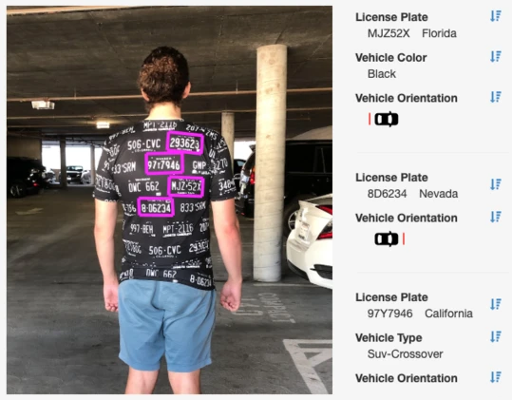

Mis-classification attacks Without any Fancy Maths
Distorted Inputs
Ref: https://adversarialfashion.com/

Slide 17
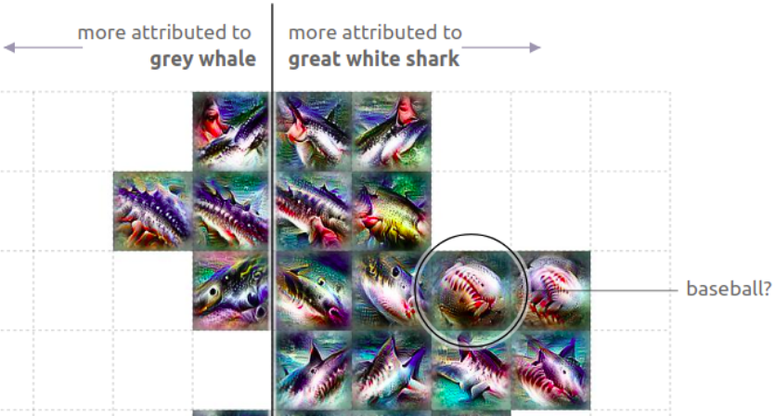
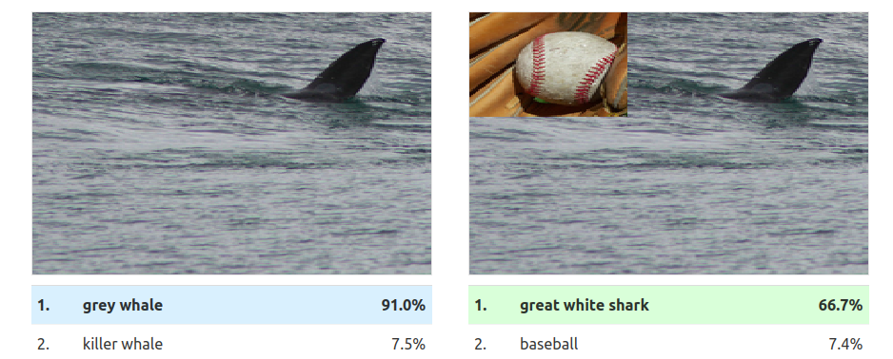


Adversarial attacks Without any Fancy Maths
https://distill.pub/2019/activation-atlas/
Adversarial text substitution
https://science.sciencemag.org/content/363/6433/1287.full?ijkey=OXnSsEp.Iagl6&keytype=ref&siteid=sci

Slide 18
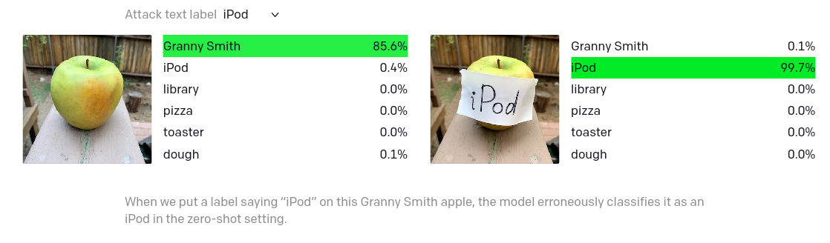
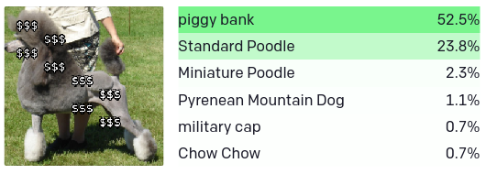
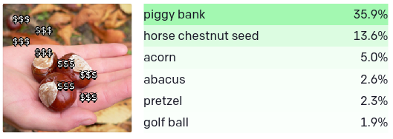
Mis-classification attacks Without any Fancy Maths
https://openai.com/blog/multimodal-neurons/

Slide 19

Adversarial Attacks on Black-Box Models
Target Class
Target Model
API
Input

Slide 20
Adversarial Attacks on Black-Box Models
Target Class
Target Model
Local Model
API
Adversarial Attack
Adversarial Sample

Slide 21
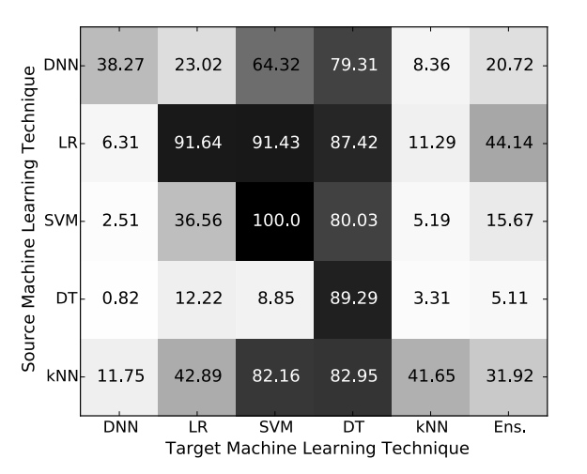
Adversarial Attacks are Transferable
Ref: https://arxiv.org/pdf/1605.07277.pdf

Slide 22
Demo: Adversarial Attacks

Slide 23
Mitigation: Adversarial Attacks

Slide 24
Adversarial Attack on FaceNet

Slide 25
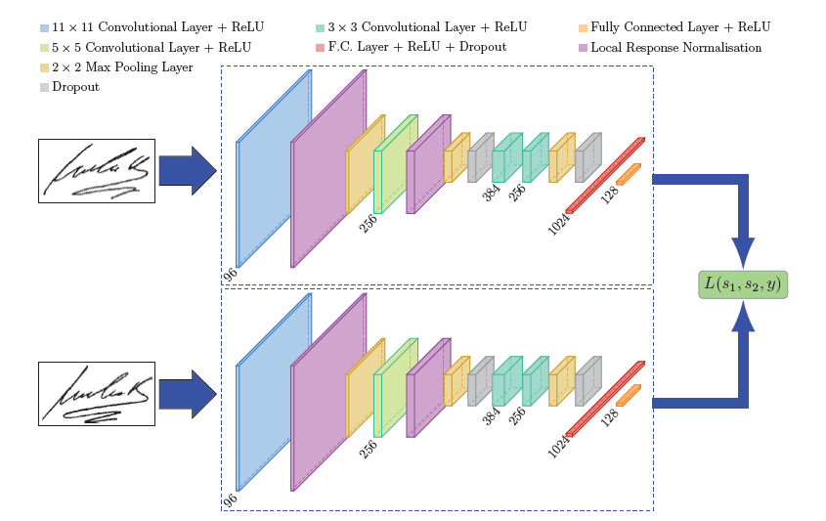
Siamese Neural Network
https://arxiv.org/pdf/1503.03832.pdf

Slide 26
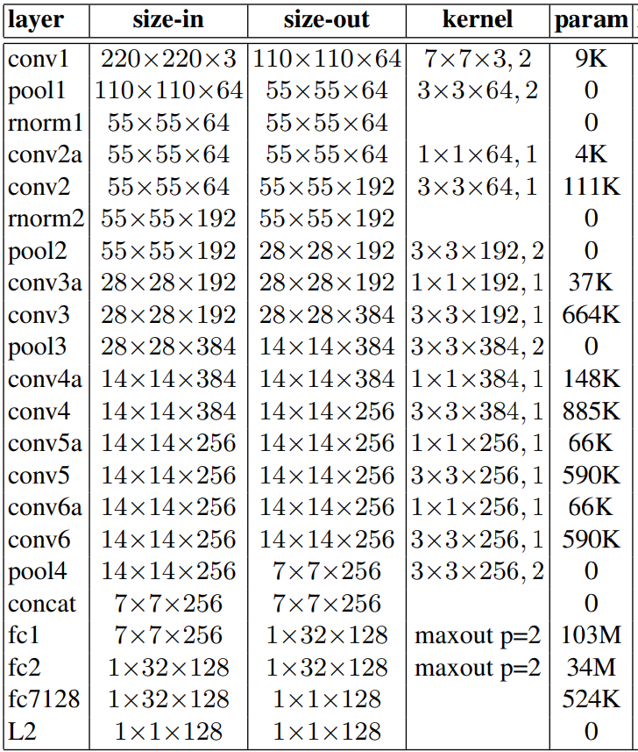
FaceNet Architecture
https://arxiv.org/pdf/1503.03832.pdf

Slide 27
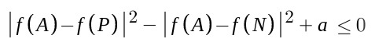
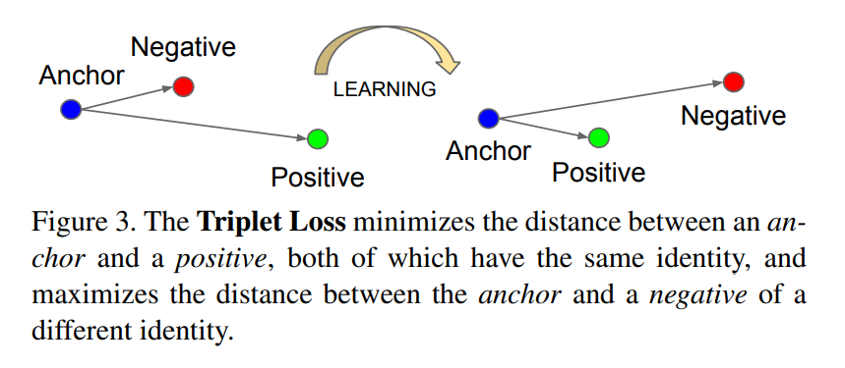
FaceNet Loss
Loss function: Triplet loss
https://arxiv.org/pdf/1503.03832.pdf

Slide 28
Demo: Adversarial Attack on FaceNet

Slide 29
Demo: Adversarial Attack on FaceNet

Slide 30
Model Stealing Attacks

Slide 31
Model Stealing Attacks
Offline Attacks
Stealing models that are deployed on device
Online Attacks
Stealing models deployed on cloud with black box access

Slide 32
Offline Model Stealing Attacks
Applications like WAF, Object detection, Antiviruses, IDS/IPS etc. require to work without internet connectivity
Models are deployed on device to make them available for prediction
Deployment may or may not employ any protection mechanism

Slide 33
Offline Model Stealing
Model could be deployed on device
Extracting from
firmware/flash storage
APK, executables
Disk
Transmitted over Network
Analyse the serialized model
Leverage recon to understand internals (like framework, algorithm, architecture, etc) of the model
Get predictions from model

Slide 34
Offline model stealing: Example

Slide 35
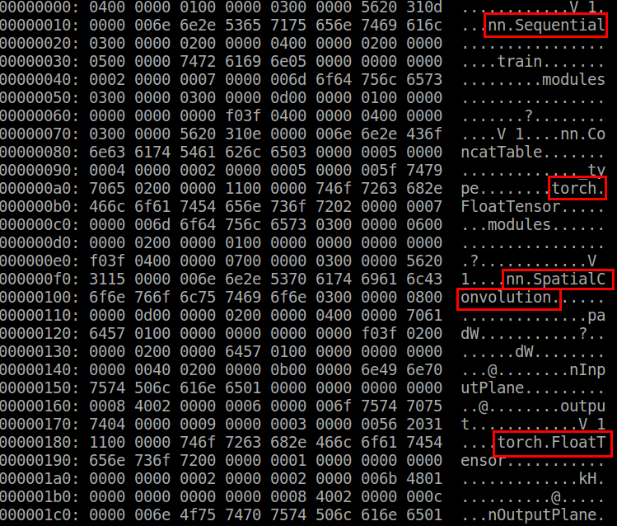

Slide 36
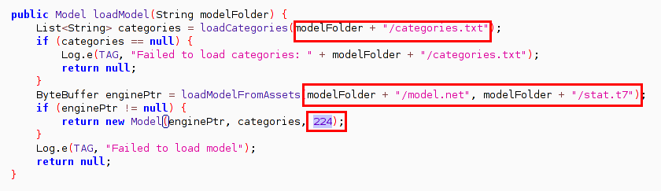
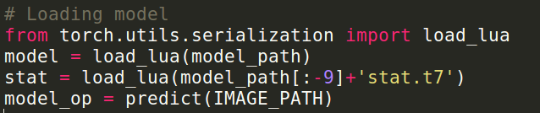
Offline Model Stealing

Slide 37
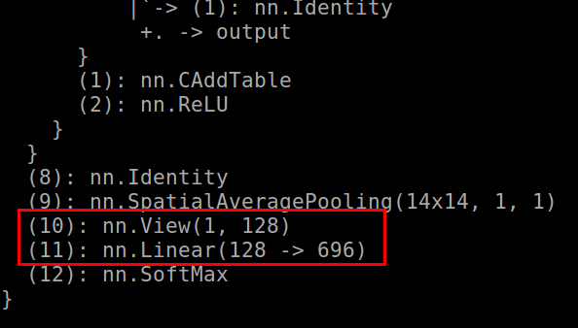
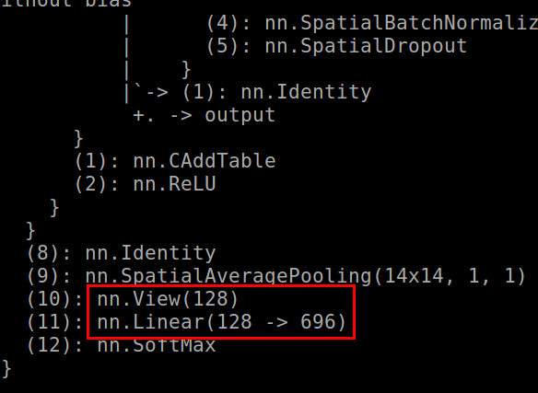

Slide 38
Demo: Offline model stealing

Slide 39
Mitigation: Offline Model Stealing Attacks

Slide 40
Online Black Box model stealing

Slide 41





MLaaS

Slide 42

MLaaS
Target Class
Trained Model
API
Input

Slide 43
Model Stealing attack methodology
Target Class
F
F’
API
Train
Input

Slide 44
Model Stealing attack methodology
Collect data
Query prediction APIs to generate labels from target Model
Use generated Labels and collected data to train a duplicate model
Optimization algorithms like Gradient descent are used to train the

Slide 45
GDALR: Black Box Model Stealing
Problem with Traditional Attack Method
It is assumed that the confidence score of all classes except predicted class is zero '0'
While in reality there is some value of confidence is associated with every class
Above assumption adds up to the gradients, which causes optimizer to change parameters of Duplicate model aggressively

Slide 46
Online Attacks
Input: [f1, f2, f3, ..., fn]
Internal F output: P(class1), P(class2), P(class3), …, P(classN)
Cloud API output: max(P(class1), P(class2), P(class3), …, P(classN))
Target Class
F
F’
API
Train
Input

Slide 47
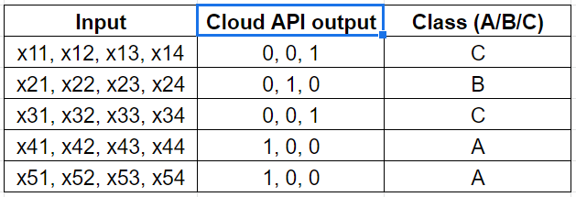
Present attack methodology
In traditional approach, attackers train their local models based on Cloud API output

Slide 48
Inefficiencies with present attack methodology
Assumptions made by traditional/present attack methodology
Input -
[1, 2, 3, 4]
Actual Output -
[0.3, 0.2, 0.5]
Output by Cloud API -
[0, 0, 1]
Assumption -
[0, 0, 1] is approximately equal to [0.3, 0.2, 0.5]

Slide 49
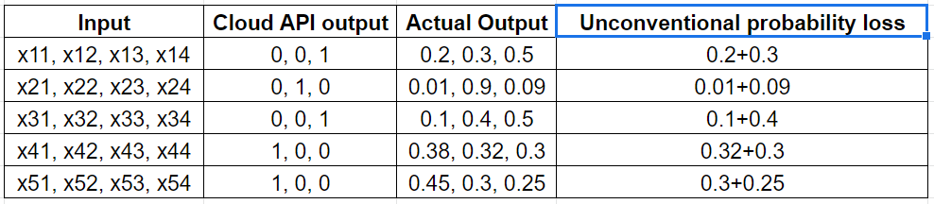
GDALR: Black Box Model Stealing

Slide 50
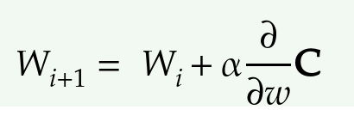
Scope for Attack optimization
1. Reconsider the way to analyze labels
Having access to all the probability values will definitely help us to clone models
2. Learning parameters in hyperspace
To Duplicate the target model we need to learn the boundaries that the target model has learnt
Considering probability of predicted class as 1 and others to be 0 will cause unwanted loss and increase the gradient
Increased gradients cause the optimizer to change weights abruptly

Slide 51
Proposed approach (GDALR)
GDALR: Gradient Driven Adaptive Learning Rate

Slide 52
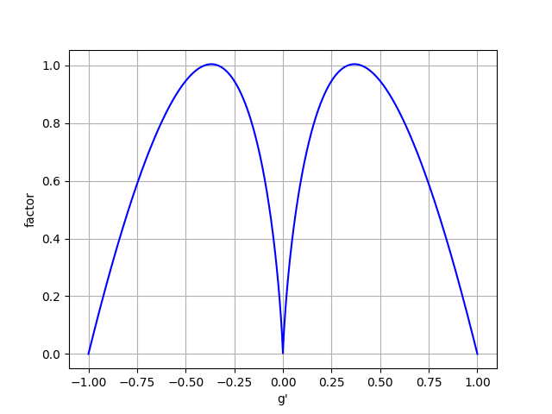
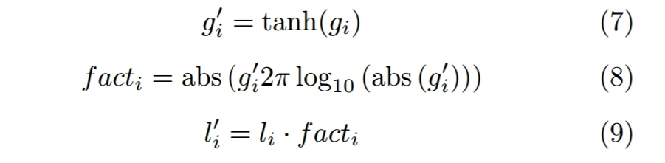
GDALR: Gradient Driven Adaptive Learning Rate

Slide 53
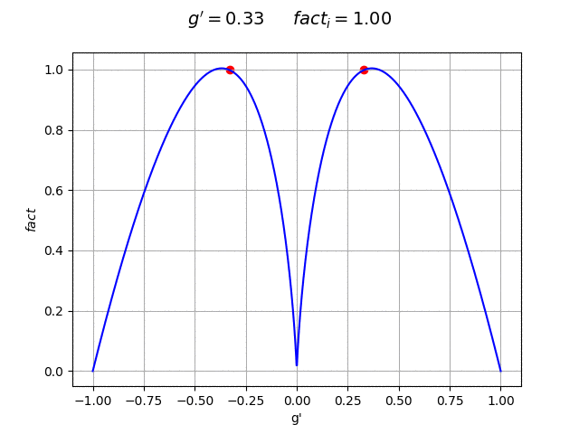
GDALR in Action

Slide 54
Experimental setup
GDALR reliability Testing -
Logistic Regression
MLP
CNN

Slide 55
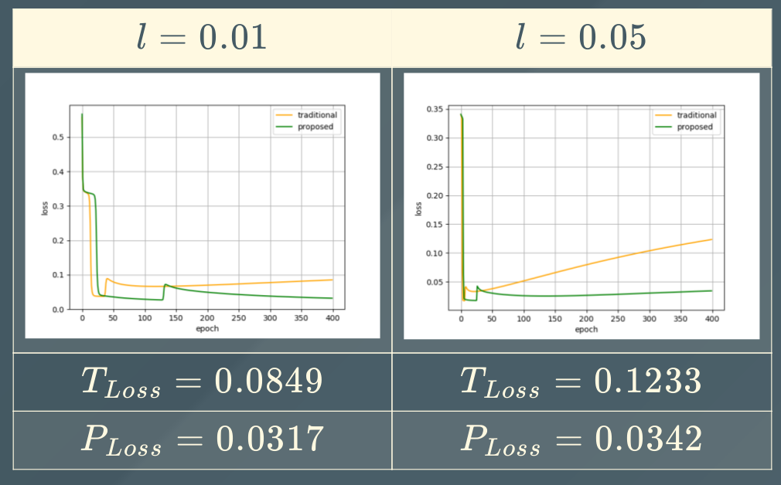
Results: Logistic Regression

Slide 56
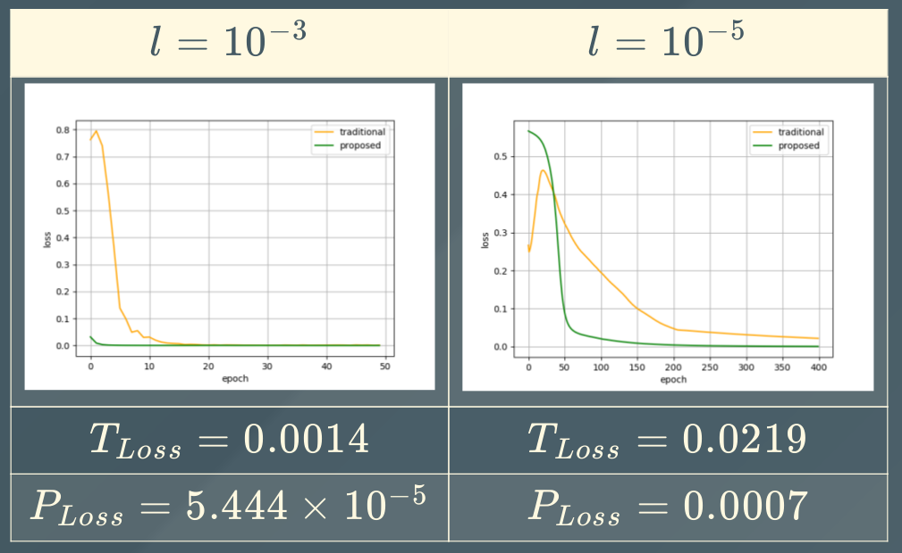
Results: Multi Layer Perceptron

Slide 57
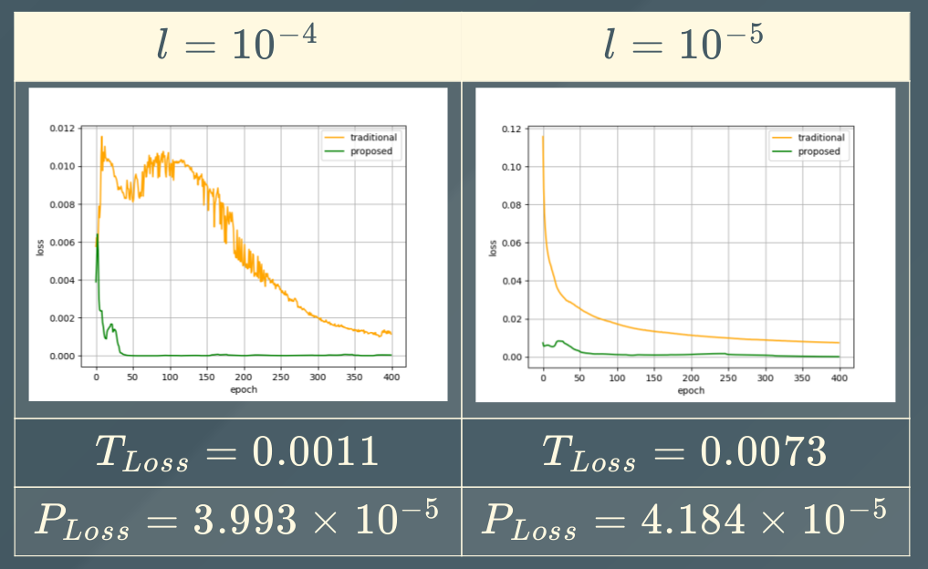
Results: Convolutional Neural Network

Slide 58
Mitigation: Online Model Stealing Attacks

Slide 59
Model skewing Attacks

Slide 60
Model skewing Attacks
Feedback

Slide 61
Model skewing Attacks
Poisoned Feedback Loop

Slide 62
https://elie.net/blog/ai/attacks-against-machine-learning-an-overview/
Demo: Skewing Spam Filters

Slide 63
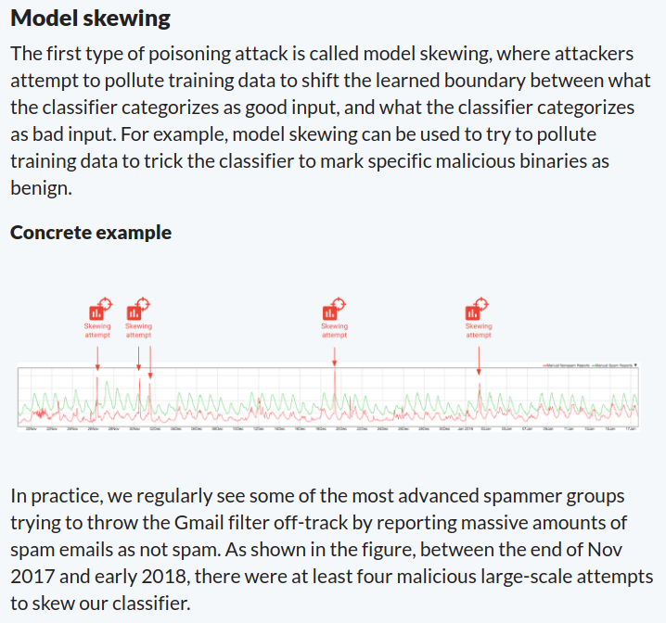
Model Skewing
https://elie.net/blog/ai/attacks-against-machine-learning-an-overview/

Slide 64
Mitigation: Model Skewing Attacks

Slide 65
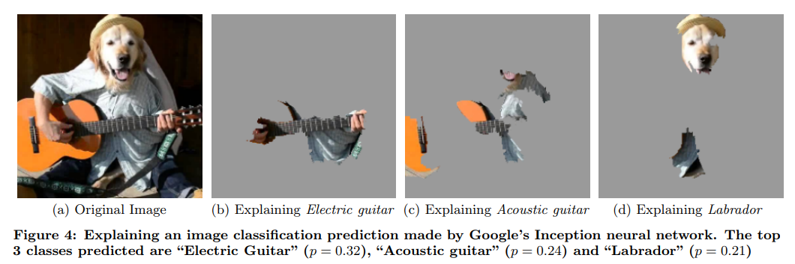
Explaining Predictions
Ref: https://arxiv.org/pdf/1602.04938.pdf

Slide 66
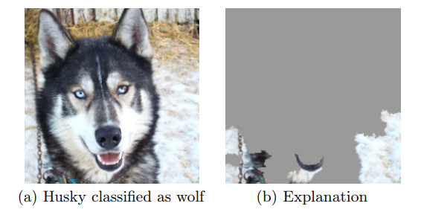
Explaining Predictions
Ref: https://arxiv.org/pdf/1602.04938.pdf

Slide 67
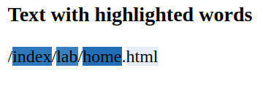
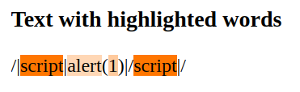
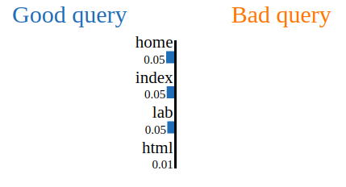
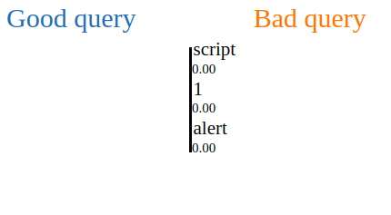
LIME to bypass WAF
query: /index/lab/home.html
query: /<script>alert(1)</script>/

Slide 68
Demo: LIME

Slide 69
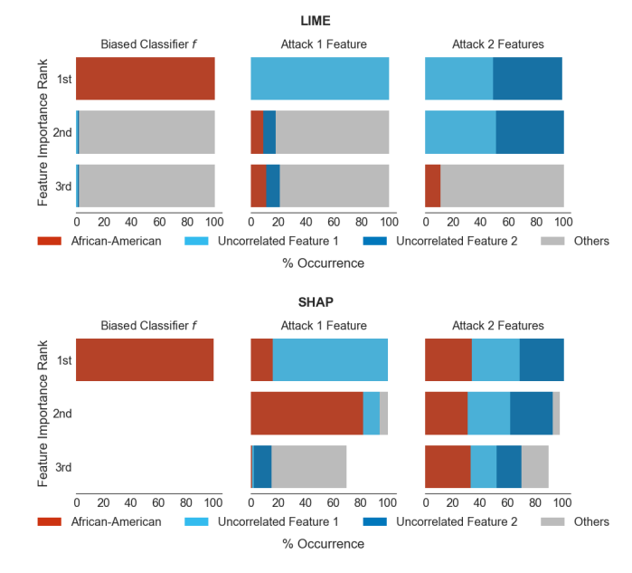
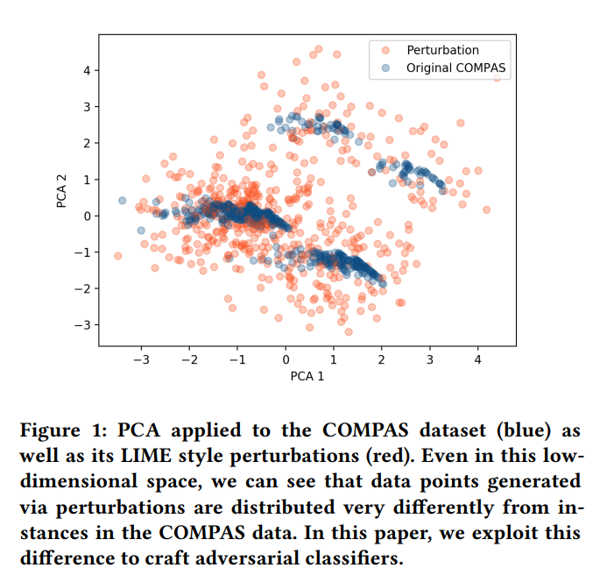
Fooling LIME and SHAP
https://arxiv.org/pdf/1911.02508.pdf

Slide 70
Demo: Attack WAF

Slide 71
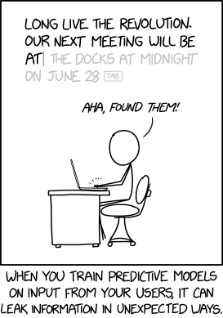
Unintended Memorization in Neural Networks
Ref: https://www.usenix.org/system/files/sec19-carlini.pdf

Slide 72
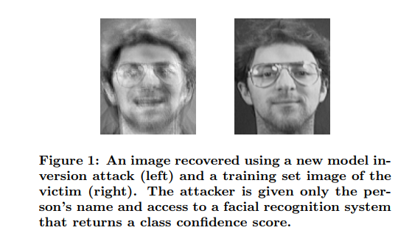
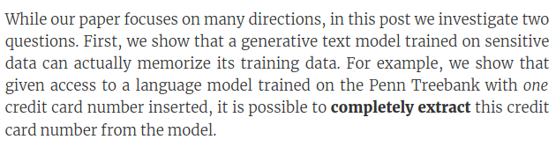
Input data inference Attack
Query the target model to extract sensitive data from the dataset used to train the model
Ref: https://bair.berkeley.edu/blog/2019/08/13/memorization/
Ref: https://www.cs.cmu.edu/~mfredrik/papers/fjr2015ccs.pdf

Slide 73
Framework exploits for
CVE 2017-12603 : Heap Overflow
by @gauravnayak210

Slide 74

Framework exploits for by @gauravnayak210

Slide 75
Other Attacks
Network Attacks
Hybrid attacks
Model Stealing + Adversarial Learning = Whitebox Adversarial Learning attack
Poor authentication on feedback APIs + bots = Model Skewing
No encryption while downloading the model + MITM = Model Stealing
SQL injection on Application + Inject bad data = Data poisoning
Vulnerabilities/0days in the frameworks

Slide 76
Mitigation
Adversarial Training, Ensemble learning, Defence Distillation, Reduced feature space
Identify and patch Bias in models, avoid overfitting
Sanitize input datasets and quantize the models
Sanitize feedback inputs from users
Evaluate re-trained model against golden dataset
Standard application and data protection practices

Slide 77




ML Security Assessment Process
Start
Understanding the Application
Use-case
Product Capabilities
Implementations
Understanding the ML Pipeline
Gather Test Cases If Any
Attack Surface Identification
Actors and Entity Boundaries
Possible Attacks identification on Exposed endpoints
Possible attack vectors
Threat Modeling
Understand ways with which end users communicate with model
Simulate end user interaction
Model Endpoints

Slide 78



ML Security Assessment Process
Adversarial Learning Attack
Craft inputs to bypass fool classifiers
Use custom built tools
Automated generation of theoretically infinite zero day samples as possible
Model deployed locally?
Reverse engineer deployed application
Model deployed on cloud?
Custom built scripts for black-box model stealing attacks
Model Stealing Attack
Model Skewing and Data poisoning Attack
Simulate Feedback loops abused by attackers
Quantify the skewness of model
Model Inversion and inference
Get access to model via valid or compromised communication channels
Infer sensitive samples from training dataset from model
Framework/ Network/Application assessment
Identify traditional vulnerabilities in application
Leverage them for above attacks

Slide 79

ML Security Assessment Process
Reporting and Mitigation
Comprehensive Mitigation Proposal
Work With Developer/SME for implementations
End

Slide 80
Thanks
@adversarial_nik

